Slide 1
The Archaeological Artefacts of Swanbourne
C. N. Rodgers, © 2013

Slide 2
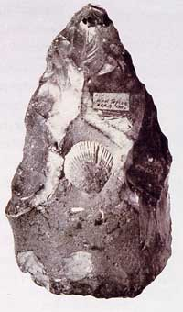
Stone age flints show percussion marks around the edge. A single flint tool has been found from Swanbourne. Iron age coins have been found in Hoggeston
Hand axe

Slide 3
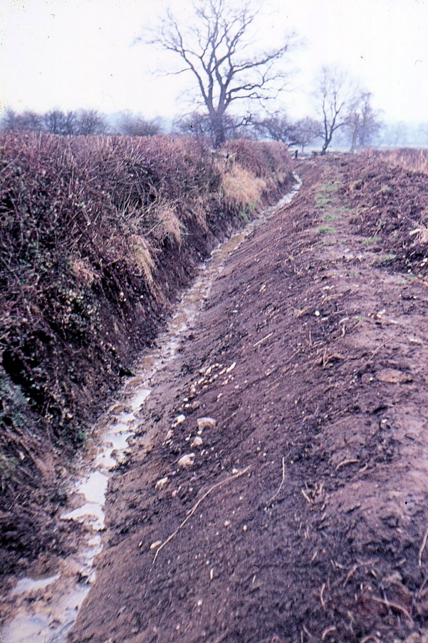
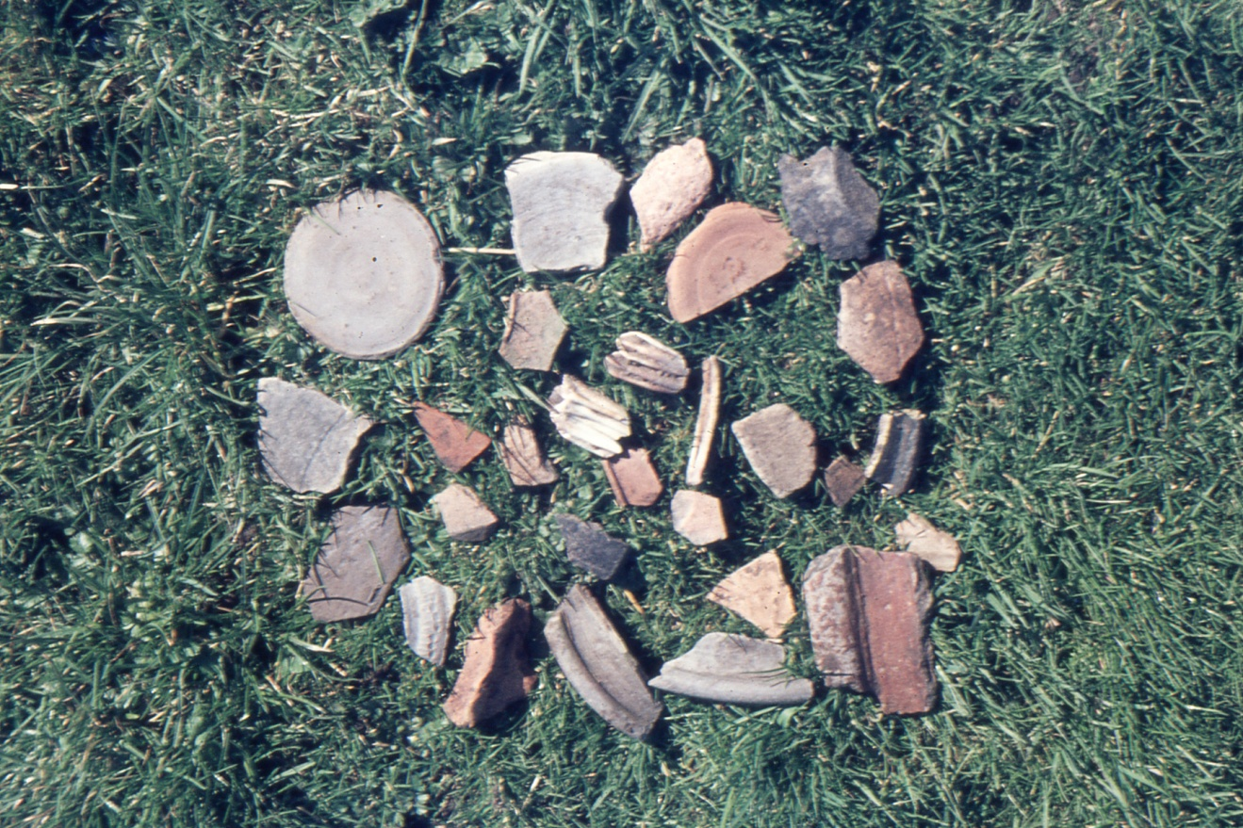
Ditch digging resulted in Ken Reading finding Roman pot remains; early 1990’s

Slide 4
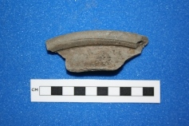
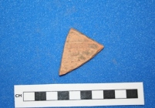
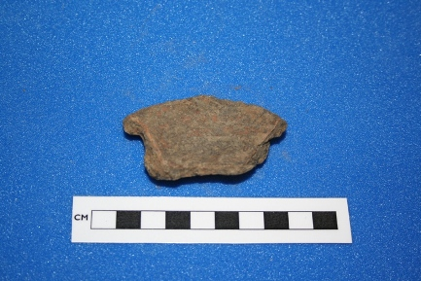
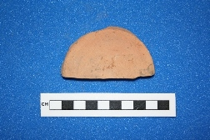
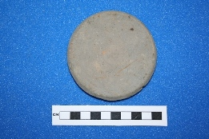
Roman pottery fragments found by Ken Reading between Swanbourne and Hoggeston

Slide 5
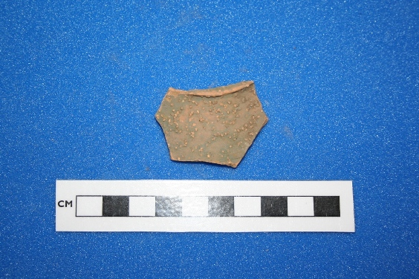
Roman pottery fragment - tableware with dot decoration.

Slide 6
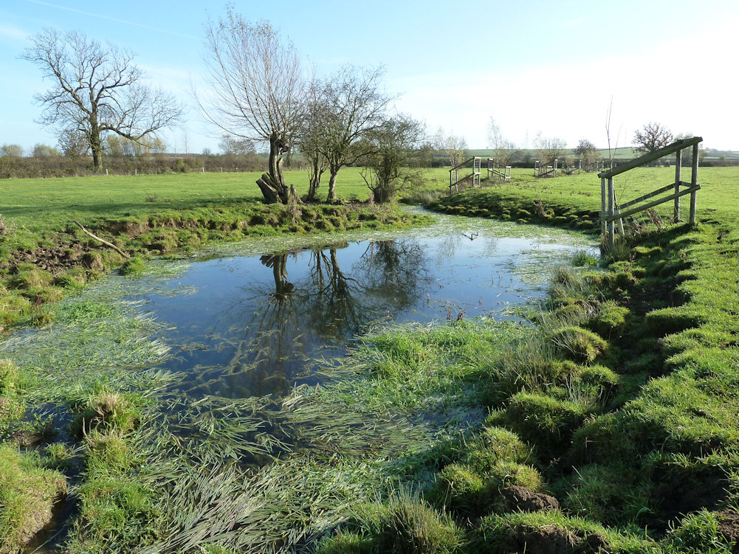
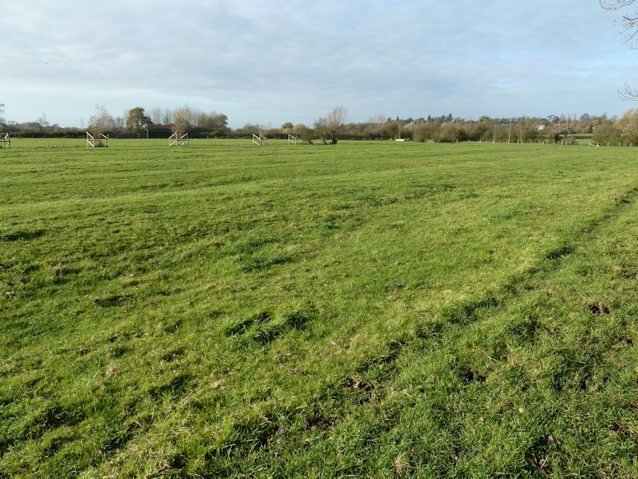
Ridge and furrow fields between Swanbourne and Hoggeston

Slide 7
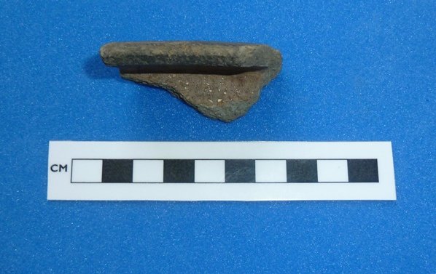
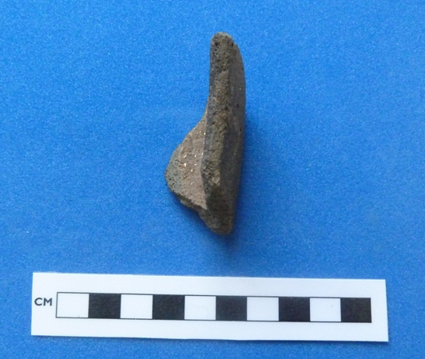
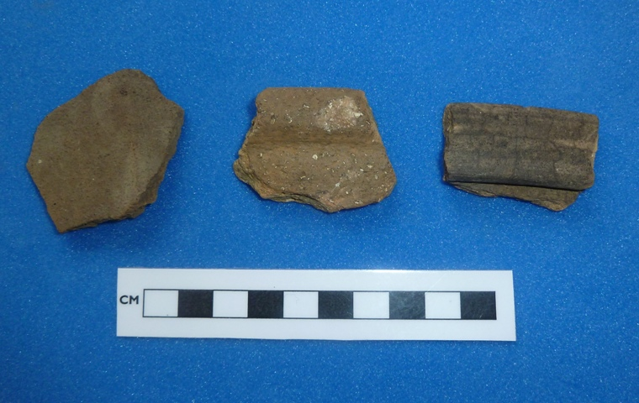
Saxo-Norman to Medieval pottery fragments from Swanbourne

Slide 8
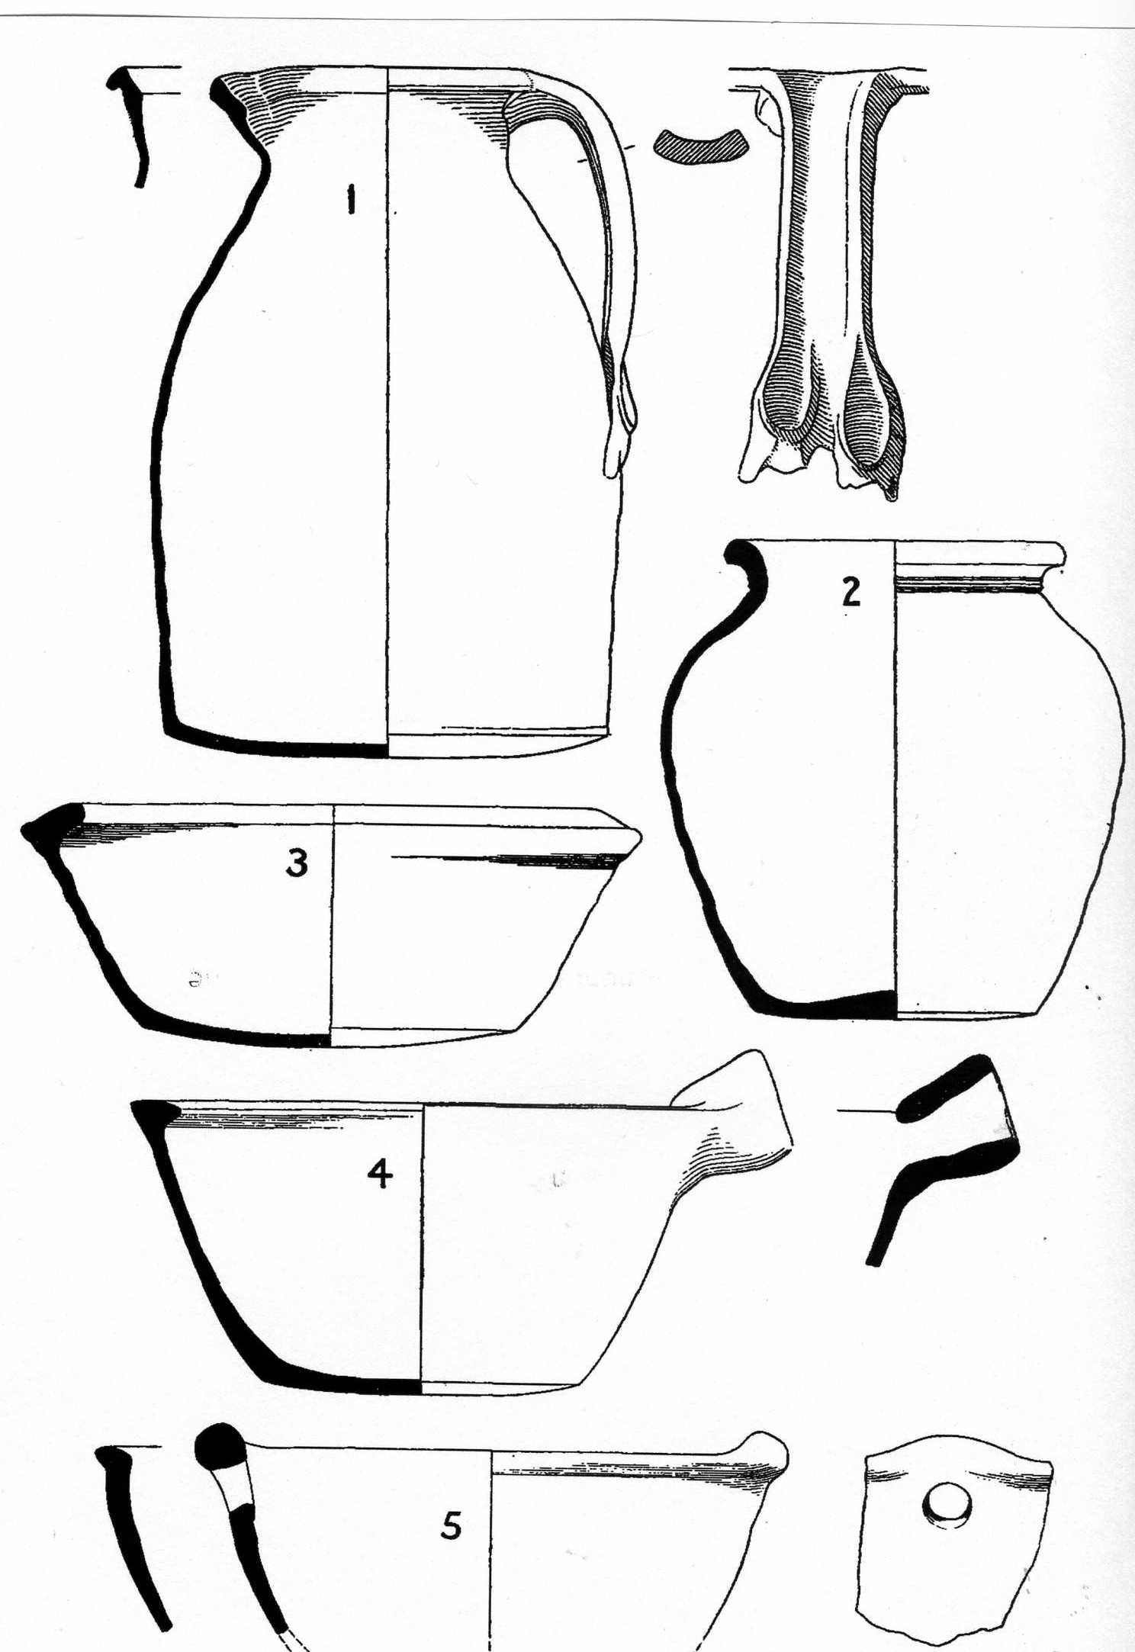
Late Saxon pottery

Slide 9
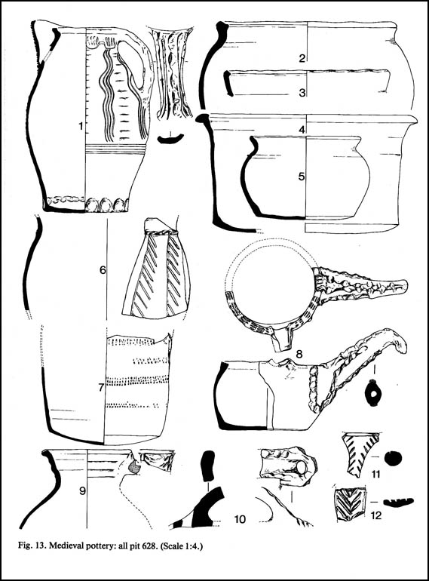
Medieval pottery

Slide 10
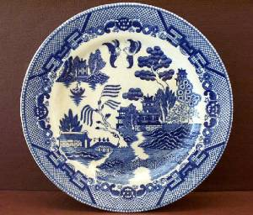
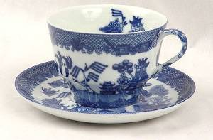
Blue Willow Pottery
Blue Willow pottery was in common useage in the 1700s. It was first manufactured at Caughley Pottery Works by Thomas Turner. Blue Willow pieces quickly grew to become popular dishes for use in the home. Fragments are common in gardens around Swanbourne.

Slide 11
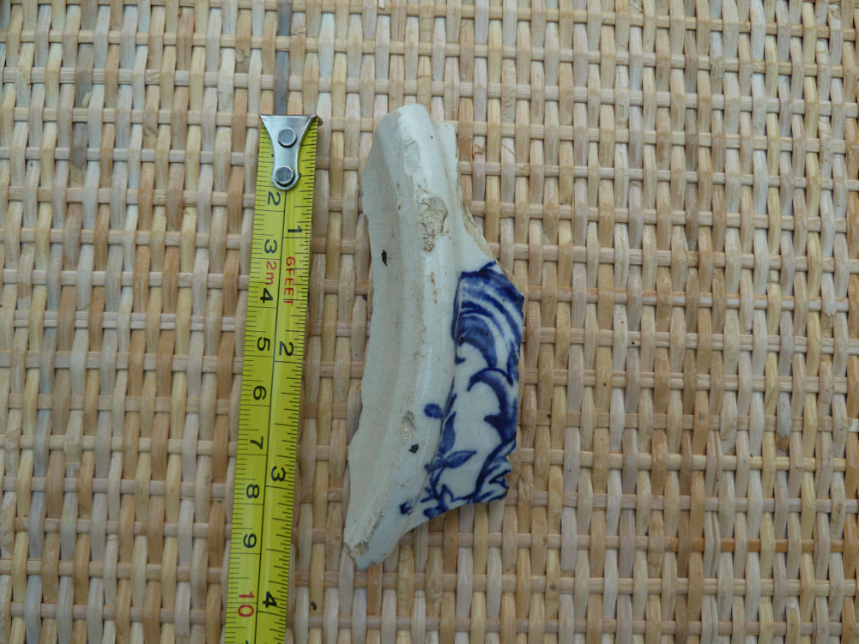
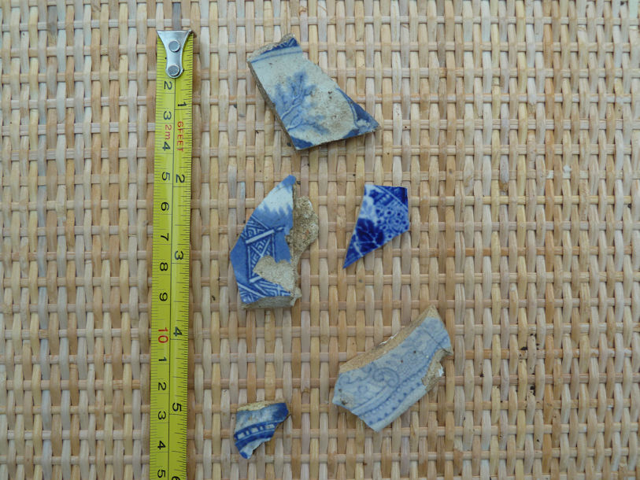
Comparision of early willow leaf with brush strokes (left) with later willow leaf with transfer background dots (right).

Slide 12
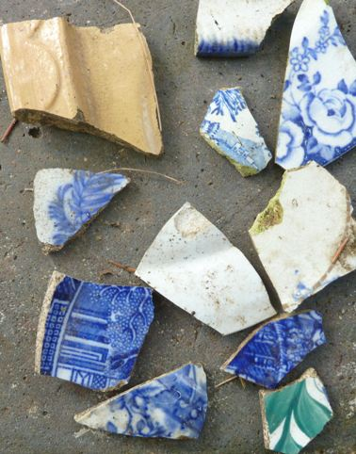
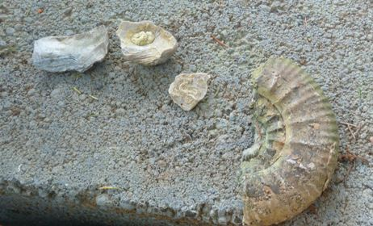
What you might expect to dig up – examples from Station Road

Slide 13
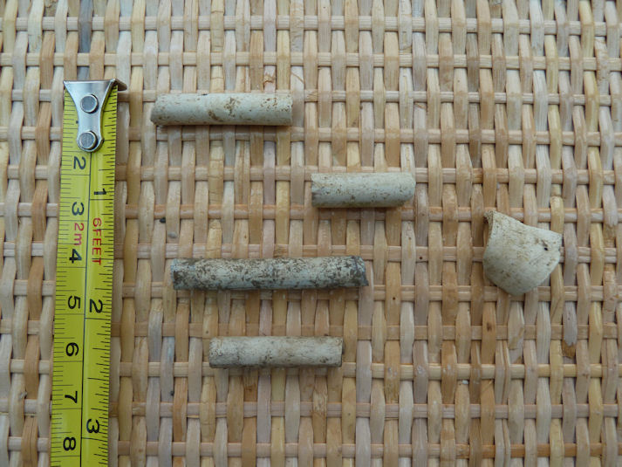
Clay pipe fragments date from the 17th to the 19th century (from Charlton Close)

Slide 14
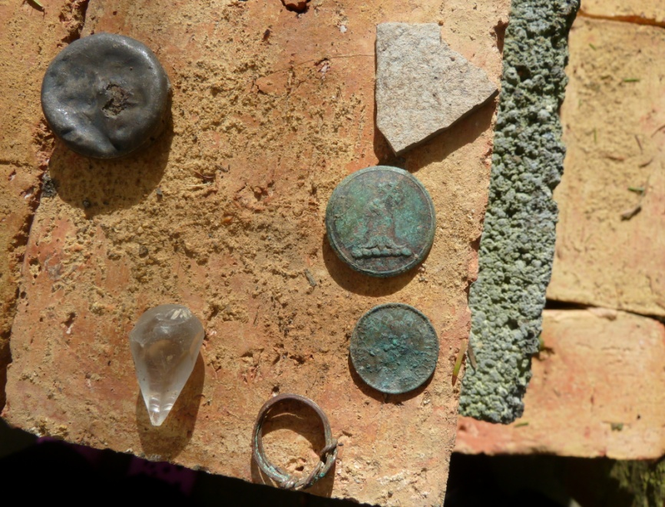
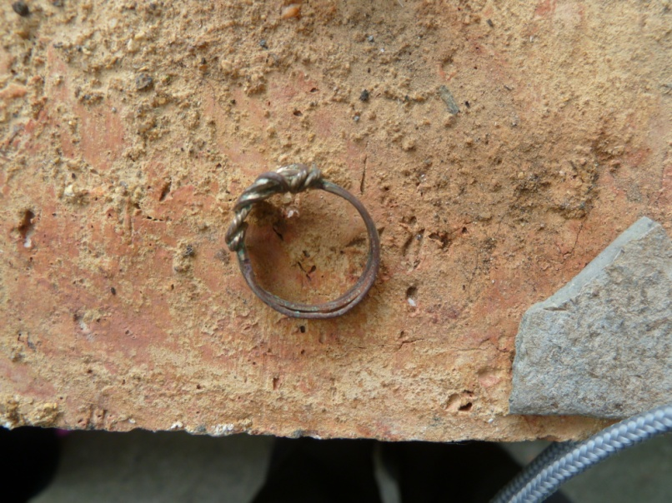
Metal objects – Station Road

Slide 15
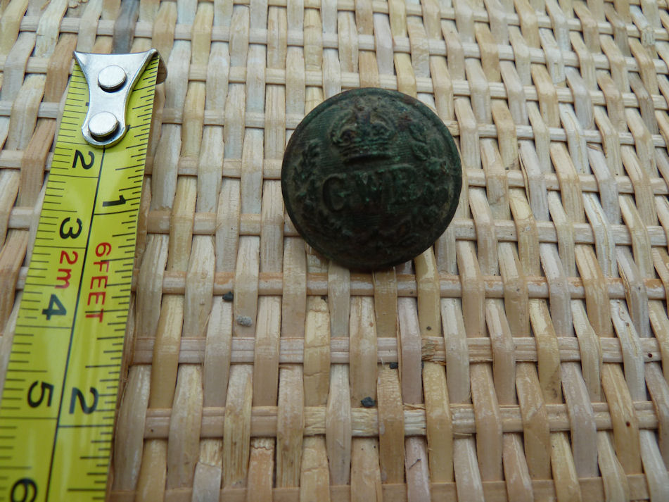
Great Western Railway employee’s brass button

Slide 16
The End
© C. N. Rodgers 2013
Swanbourne History Group, Bucks.

