Slide 1
The Geological History of Swanbourne & Aylesbury Vale
Part 1

Slide 2
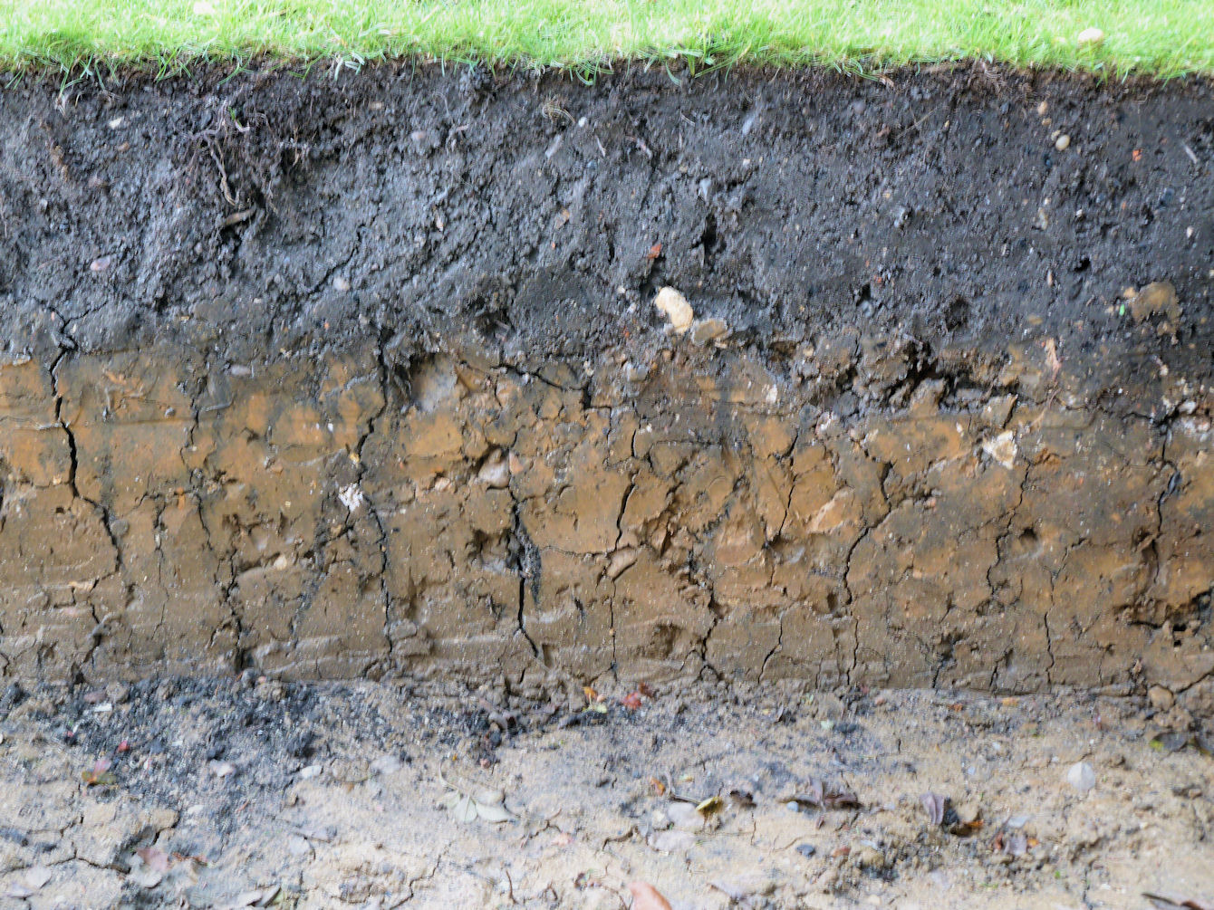
Superposition – shown in a soil section in Swanbourne

Slide 3
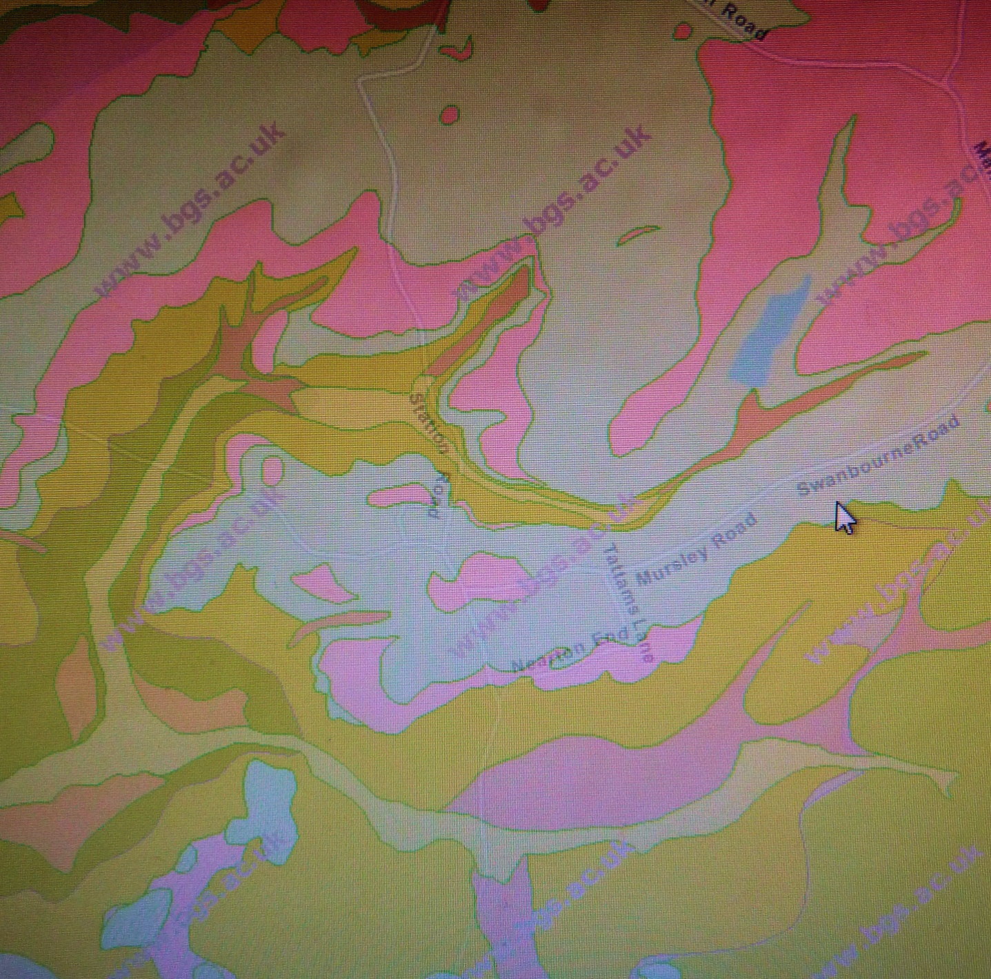
Geological map of Swanbourne

Slide 4
JURASSIC AND CRETACEOUS PERIODS
Sedimentation in sub-tropical latitudes

Slide 5
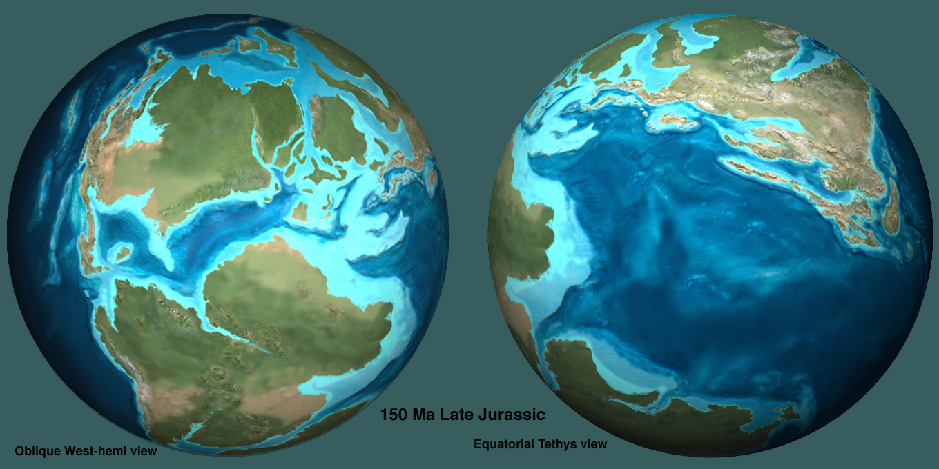
The world 150 million years ago in late Jurassic times showing the break up of Pangea, the ancient supercontinent

Slide 6
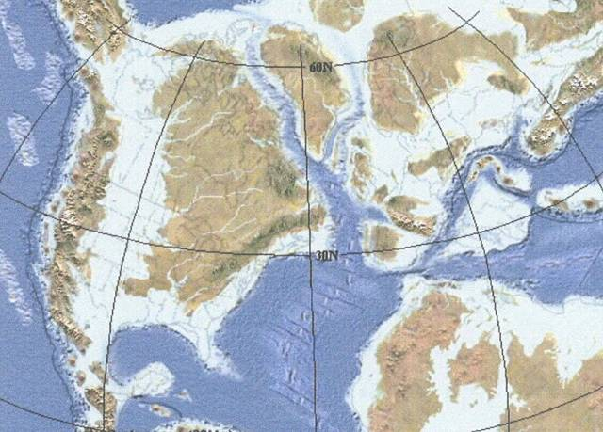
The North Atlantic is beginning to open along constructive plate margins to the E and W of Greenland. North America and Eurasia are separating. Shallow seas, shown in pale blue, are found above many areas of continental crust, giving widespread shallow water deposition on continental shelves.
UK

Slide 7
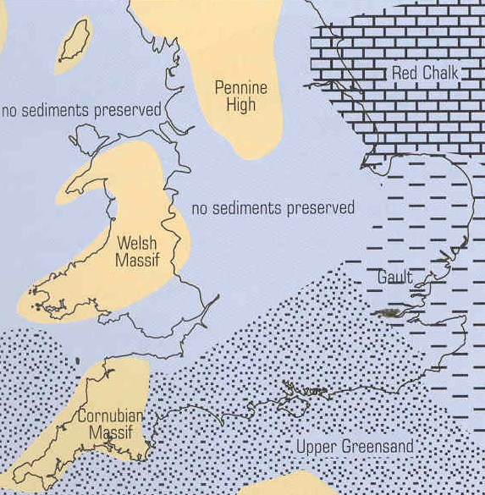
Lower Cretaceous palaeogeographic map
This map shows that most of the area that is now the UK was covered by water in the Lower Cretaceous, although different sediments were deposited in different places. In the Upper Cretaceous sea-level rose again so that Chalk was deposited everywhere.
clay
sands

Slide 8
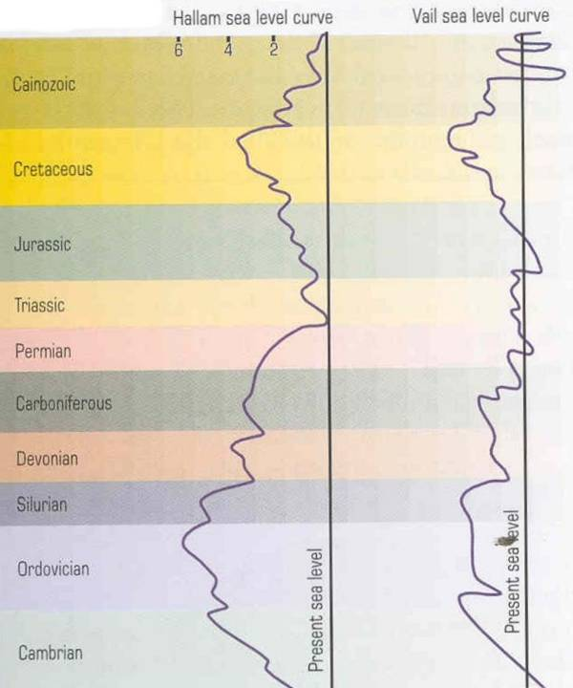
Sea-levels rose during the Jurassic and Cretaceous periods. As Pangaea broke apart, constructive plate margins displaced ocean water onto continental shelves. Fluctuating sea-levels in the Jurassic and Cretaceous periods led to a great variety of deep and shallow water continental shelf sediments.
higher
lower

Slide 9
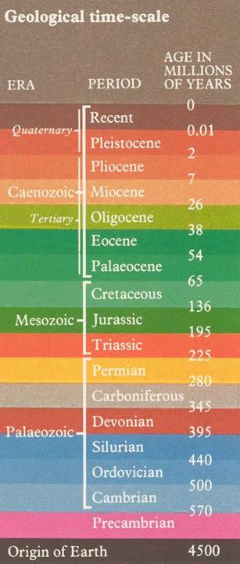
Stratigraphic table
PHANEROZOIC EON
Jurassic and Cretaceous periods
MESOZOIC ERA

Slide 10
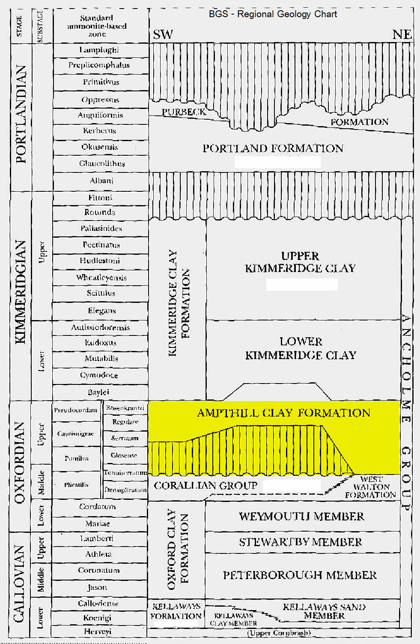

Slide 11
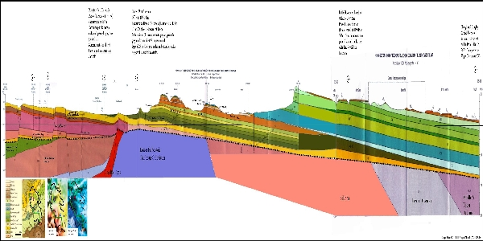
The rocks exposed at the surface in Buckinghamshire range from the Quaternary glacial deposits (less than 2.6 million years old) to the Upper Lias (Jurassic 190 million years old) in the north of the county. However, this is only part of the story, below the surface much older rocks are present.
The figure below shows a cross section through Buckinghamshire from north to south. The different rock layers are shaded by different colours. In order to display such a long distance, the section has been squeezed and the vertical scale exaggerated. The rocks dip to the South-East by 1 to 2 degrees.
Swanb
Whitchurch
Ayls
Chilterns

Slide 12
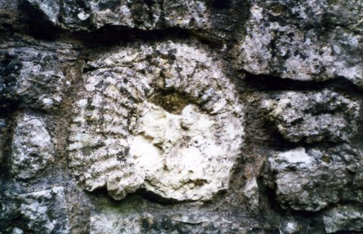
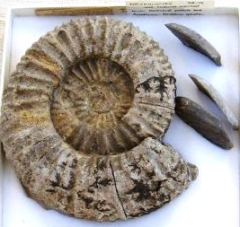
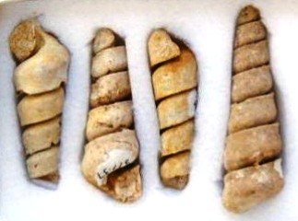
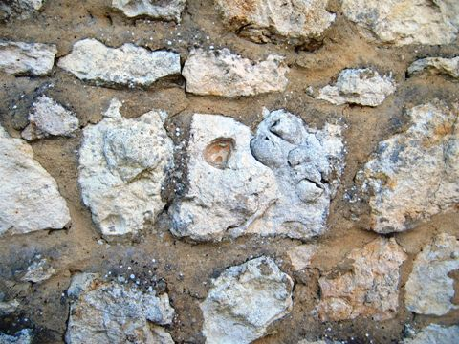
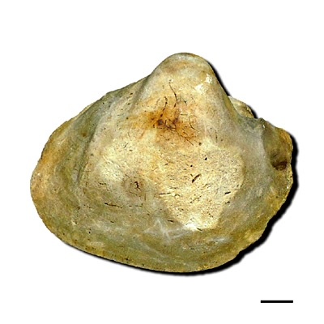
Local ammonites, gastropods and bivalves

Slide 13
Bivalve fossils normally have two valves that are mirror images of each other.
There are exceptions to this in both modern and fossil species, where the valves are asymmetrical.
E.g. Gryphea from the Jurassic, an ancient oyster. This is the fossil you are most likely to dig up in the garden, as they are common in the Oxford Clay.
Gryphea – the “devil’s toe nail”

Slide 14
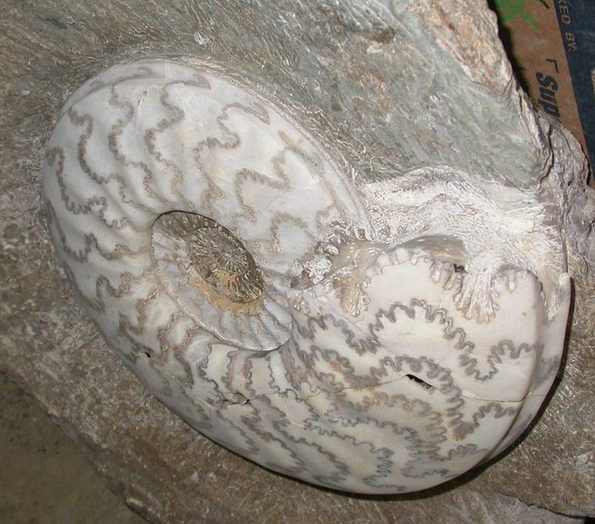
Ammonite suture shapes help to identify them
Ammonite suture lines
septum

Slide 15
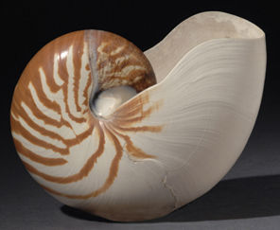
Nautilus from the Pacific Ocean is the nearest living relative of ammonites today

Slide 16
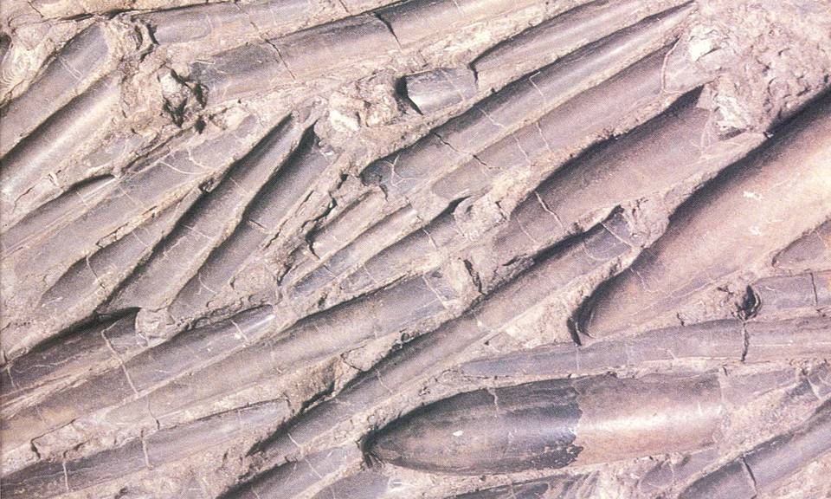
Belmnites are are ancestors of the cuttlefish. They are the internal bones of these ancient squid. They look like bullets and may be found in gardens in this area. They are made of calcite.

Slide 17
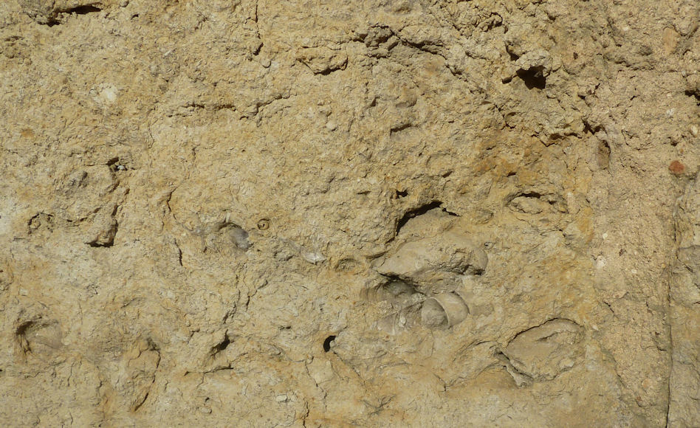
The Portland Limestone as seen in buildings around Swanbourne

Slide 18
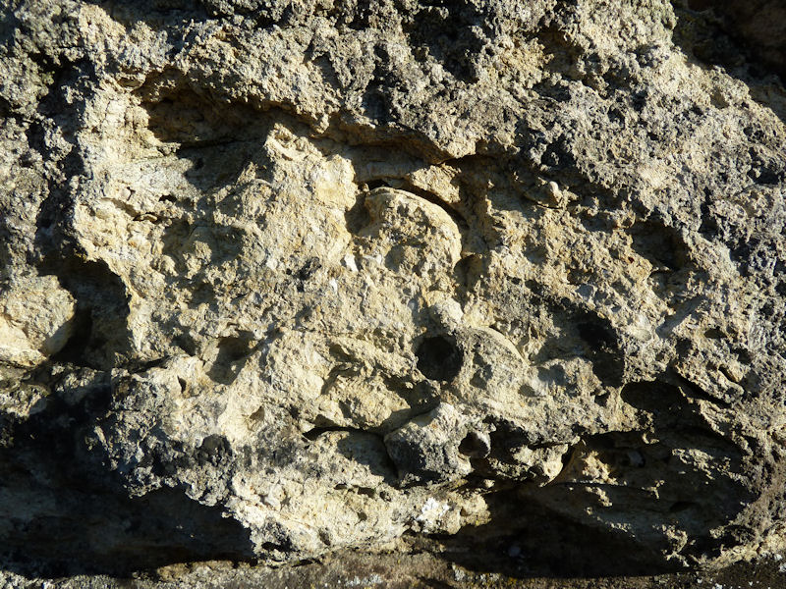
Most pieces of Portland Limestone show shell sections

Slide 19
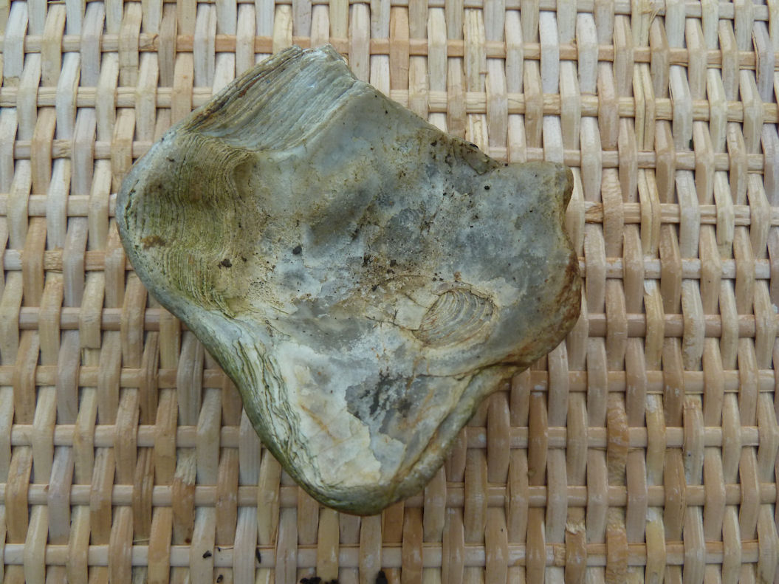
Clams & oysters today and a Jurassic fossil oyster (Gryphaea) from the clay of Charlton Close (bottom right)

Slide 20
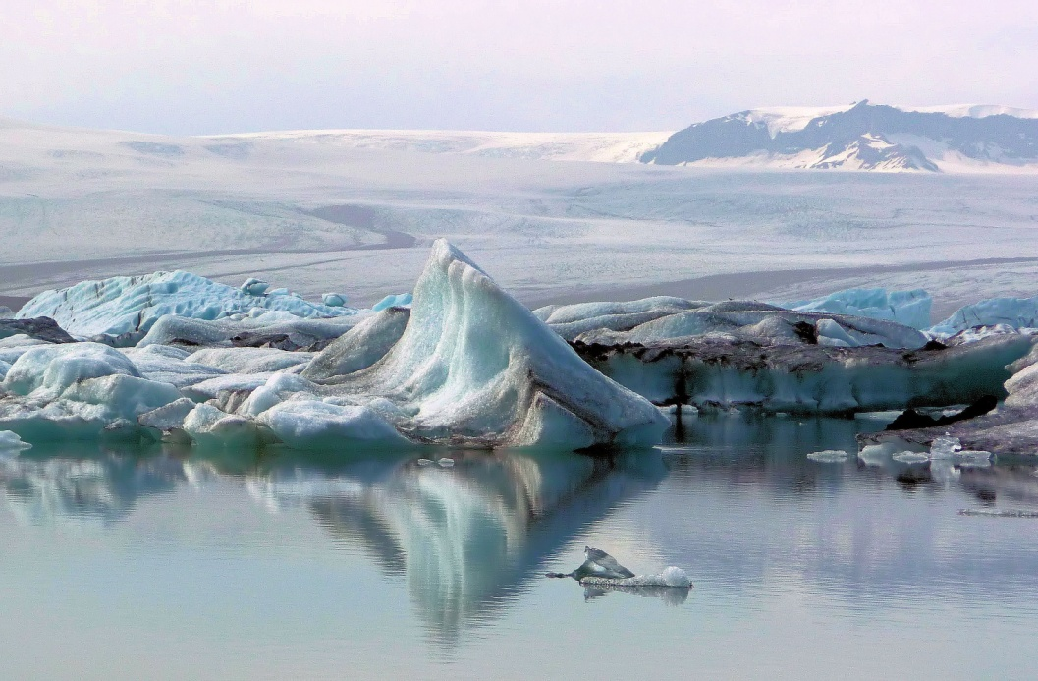
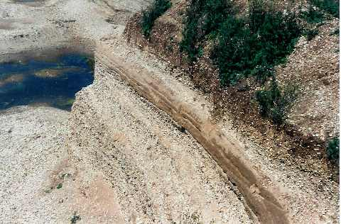
Twenty million years ago, the Alpine earthy movements uplifted South East England. Within the last two million years, the climate has been cool enough to result in four major glacial advances. Only the penultimate one reached us with glaciers melting here. The result is a thin superficial deposit in many places above the bedrock of either boulder clay or outwash sands and gravels.
The Ice Age

Slide 21
The Archaeology of Swanbourne
Part 2

Slide 22
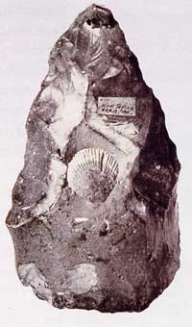
Stone age flints show percussion marks around the edge. A single flint tool has been found from Swanbourne. Iron age coins have been found in Hoggeston
Hand axe

Slide 23
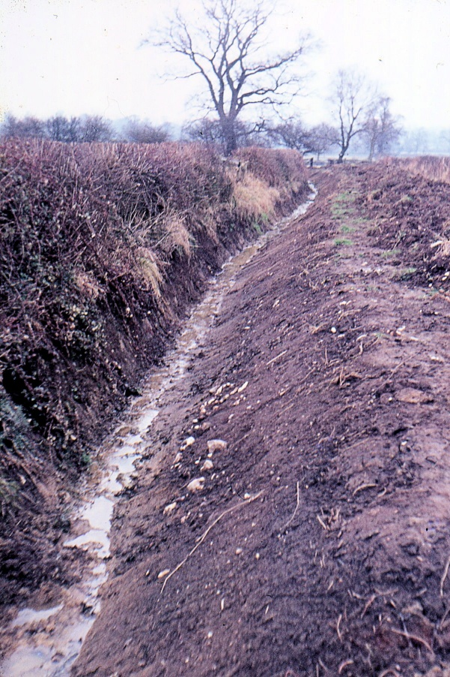
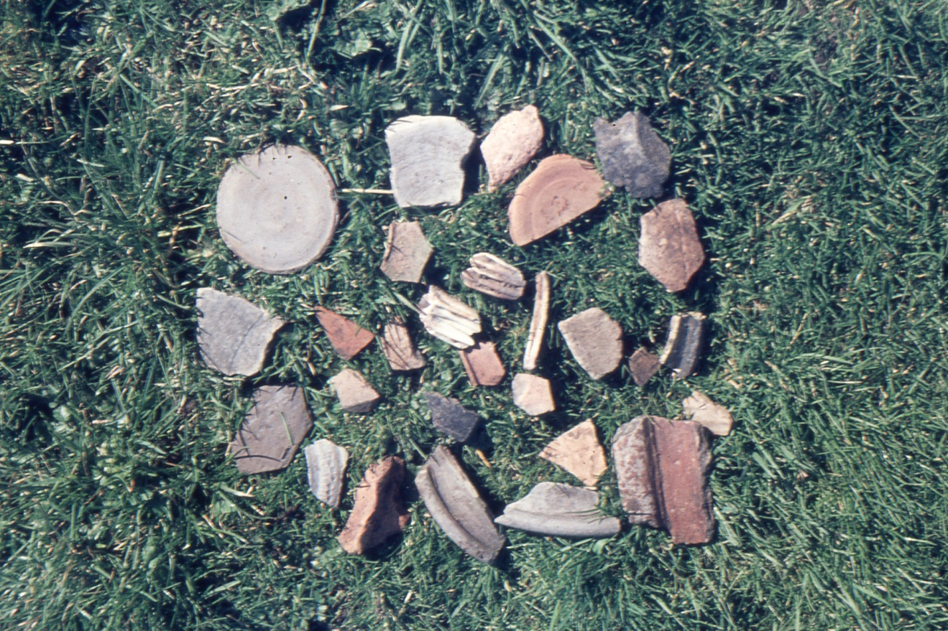
Ditch digging resulted in Ken Reading finding Roman pot remains; early 1990’s

Slide 24
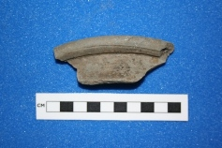
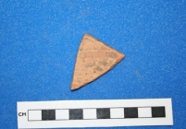
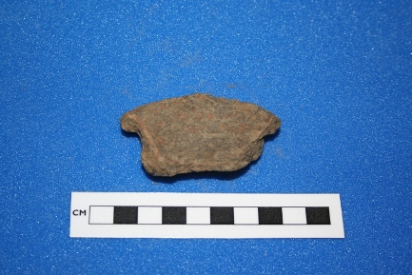
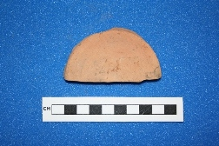
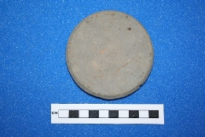
Roman pottery fragments found by Ken Reading between Swanbourne and Hoggeston

Slide 25
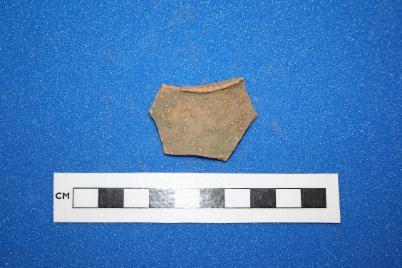
Roman pottery fragment - tableware with dot decoration.

Slide 26
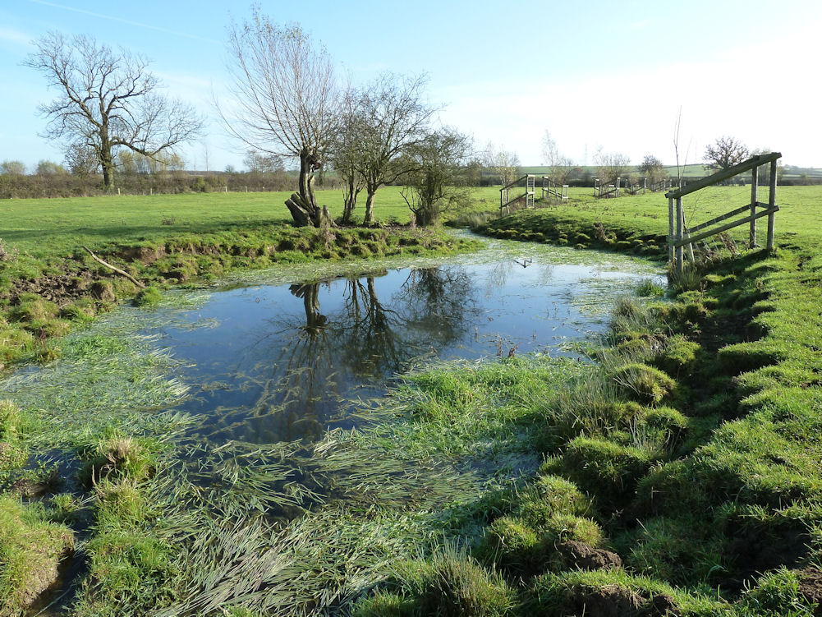
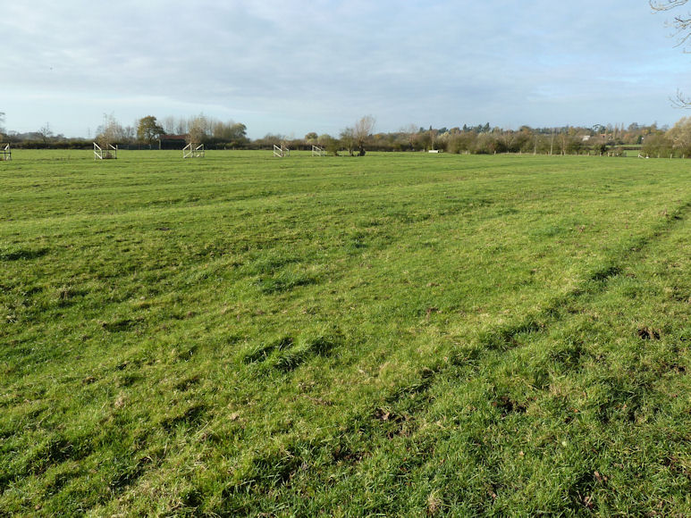
Ridge and furrow fields between Swanbourne and Hoggeston

Slide 27
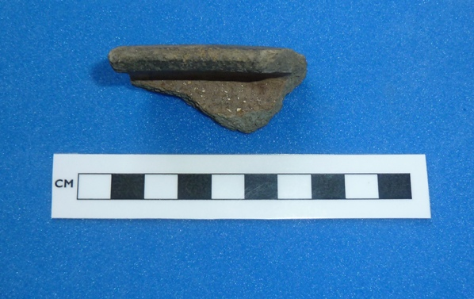
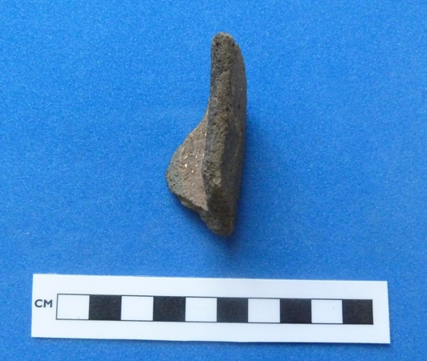
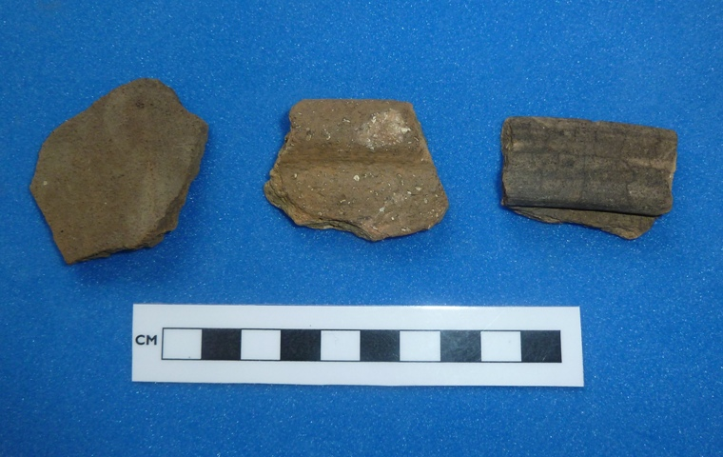
Saxo-Norman to Medieval pottery fragments from Swanbourne

Slide 28
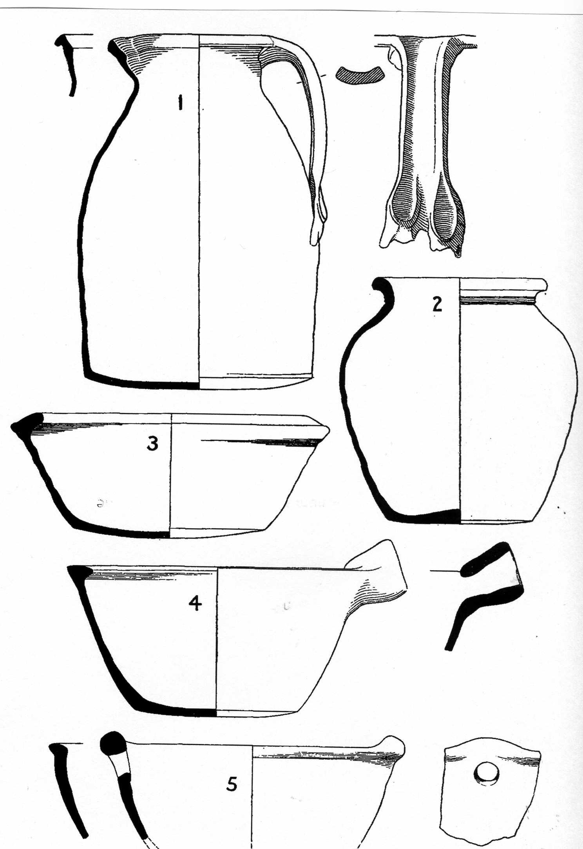
Late Saxon pottery

Slide 29
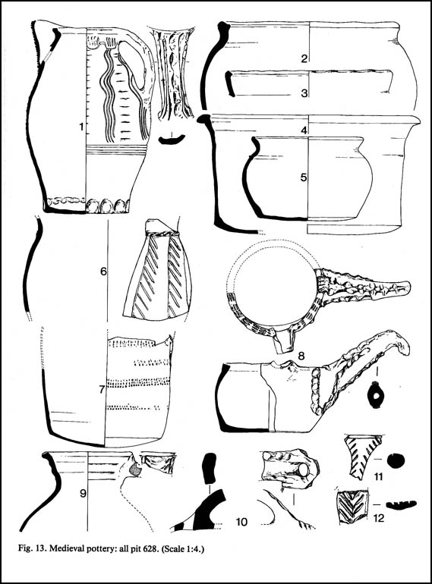
Medieval pottery

Slide 30
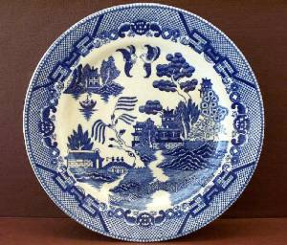
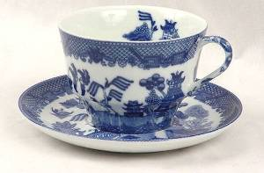
Blue Willow Pottery
Blue Willow pottery was in common useage in the 1700s. It was first manufactured at Caughley Pottery Works by Thomas Turner. Blue Willow pieces quickly grew to become popular dishes for use in the home. Fragments are common in gardens around Swanbourne.

Slide 31
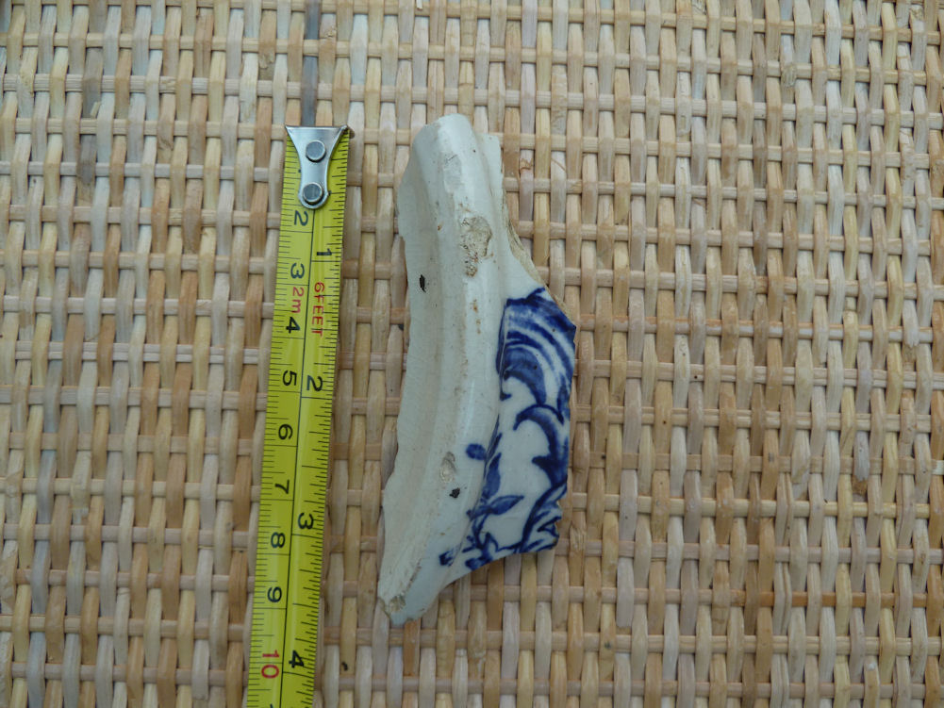
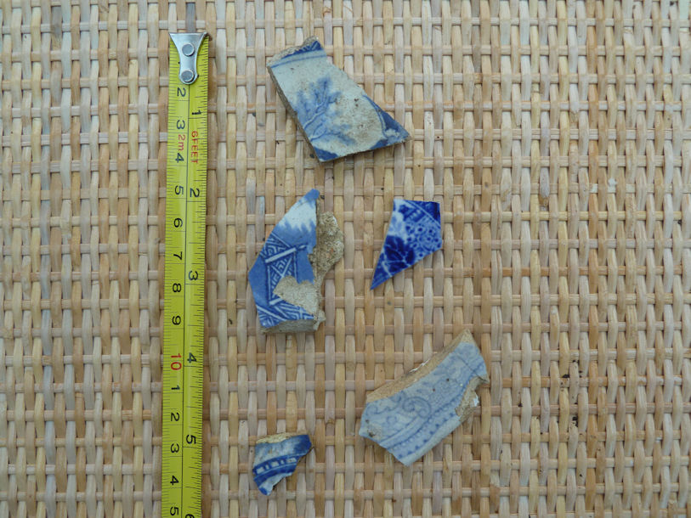
Comparision of early willow leaf with brush strokes (left) with later willow leaf with transfer background dots (right).

Slide 32
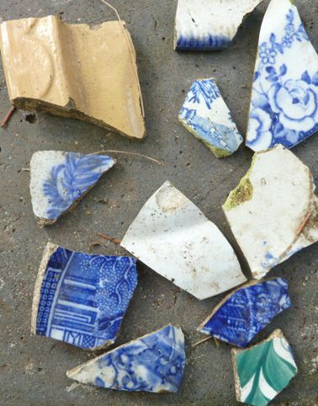
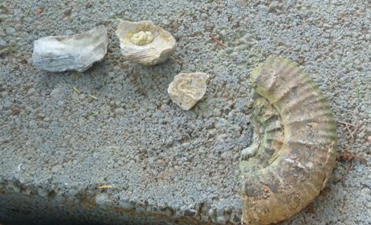
What you might expect to dig up – examples from Station Road

Slide 33
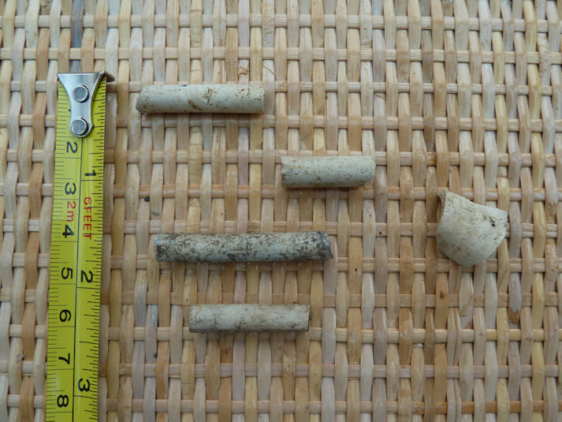
Clay pipe fragments date from the 17th to the 19th century (from Charlton Close)

Slide 34
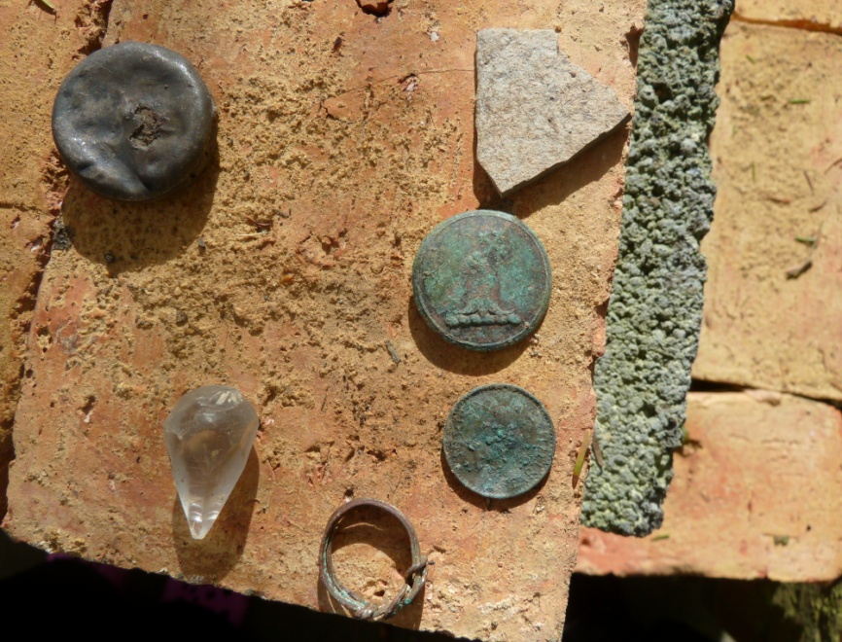
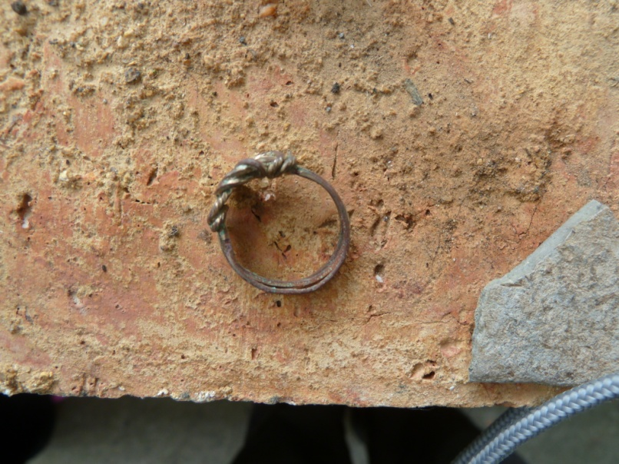
Metal objects – Station Road

Slide 35
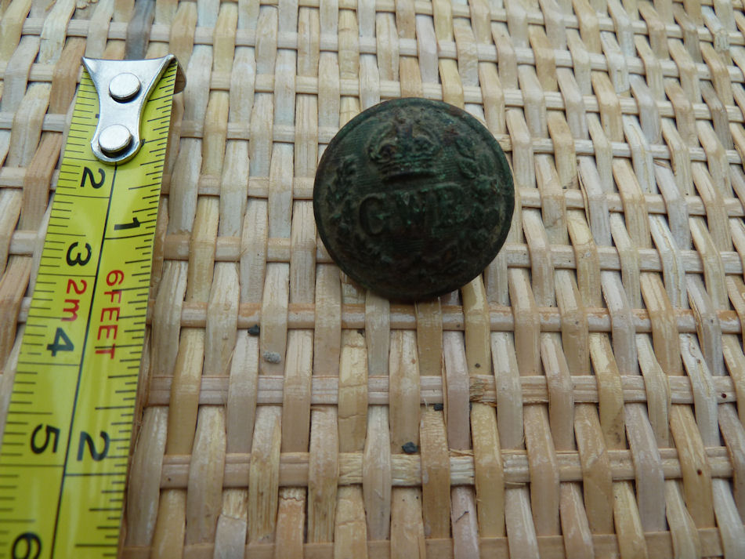
Great Western Railway employee’s brass button

Slide 36
The End

